Slide 1
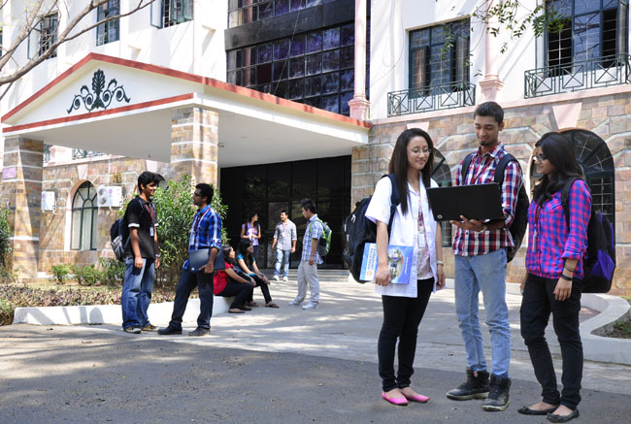

B.Tech Computer Science and Engineering – Vth Semester
Context Free Grammars
Department of Computer Science and Engineering

Slide 2
Identify the {V T P S}
Context Free Grammar
S->Sa
S->a
Identify the {V T P S}
V={S}
T={a}
S={S}

Slide 3
Identify the {V T P S}
Context Free Grammar
S->Sa
S->a
Identify the {V T P S}
V={S}
T={a}
S={S}

Slide 4
Find what is the language represented by this CFG
S->Sa
S->a
Derive at least 5 strings
Note There are 2 productions for the starting symbol S, which means we are free to start with production 1 or 2
------Derivation 1 -------------------
S->a (2)
------Derivation 2 -------------------
S->Sa (1)
->aa (2)
------Derivation 3 -------------------
S->Sa (1)
->Saa (1)
-> aaa (2)
------Derivation 4 -------------------
S->Sa (1)
Saa (1)
Saaa (1)
aaaa (2)
the Language is
L = {a,aa,aaa,aaaa,…….}

Slide 5
What is the language represented by the CFG?
S->0S1
S->01
Variables/Non Terminals = {S}
Terminal /alphabet = {0,1}
S={S}
What is the language represented by the CFG?
The above CFG can also be written as
S->0S1|01

Slide 6
Derivations
-----Derivation 1-------
S->01 (2)
-----Derivation 2-------
S->0S1 (1)
->0011 (2)
-----Derivation 3-------
S->0S1 (1)
->00S11 (1)
->000111 (2)
-------Derivation 4-------
S->0S1 (1)
->00S11 (1)
->000S111 (1)
->00001111 (2)
L={01,0011,000111,00001111,…}
L={0^{i}1^{i}|i>=1}

Slide 7
One More CFG
S->AB
S->BA
A->Aa
A->a
B->Bb
B->b
V={S,A,B}; T={a,b}, S={S}

Slide 8
Check whether the grammar accepts the string “aabaa”
S ->AB (1)
->AaB (2)
->aaB (3)
->aab (5)
A->Aa
A->a
{a,aa,aaa,aaaa,….}
B->Bb
B->b
{b,bb,bbb,bbbb,…}
S->AB – ensures strings with a followed by b
S->BA - ensures strings with b followed by a

Slide 9
Checking the language of the grammar
P->ε
P->0
P->1
P-> 0P0
P->1P1
L={ε,0,1,00,11,000,111,101,010,01010, 00100, 1001 ,0110…}
P-> ε (1)
P->0 (2)
P->1 (3)
P->0P0 (4)
->00 (1)
P->1P1 (5)
->11 (1)

Slide 10
Checking the language of the grammar
P-> 0P0 (4)
000 (2)
P->1P1 (5)
->111 (3)
P->0P0 (4)
->010 (3)
P->1P1 (5)
->101 (2)
P-> 0P0 (4)
->01P10 (5)
->01010 (2)
P-> 0P0 (4)
->00P00 (4)
->00100 (3)
P->1P1 (5)
-> 10P01 (4)
->1001 (1)

Slide 11
Check whether the Grammar accepts the string “110011” “101101”
5,5,4,1
->1P1->11P11->110P011->110011

Slide 12
CFG for arithmetic expression
E->I (1)
->a (5)
----------------
E->E+E (2)
->I+E (1)
->a+E (5)
->a+I (1)
->a+b (6)
-------------------------
E->E+E (2)
->I+E (1)
->a+E (5)
->a+E*E (3)
->a+I*E (1)
->a+b*E (6)
->a+b*I (1)
->a+b*a (5)
E->I
E->E+E
E->E*E
E->(E)
I->a
I->b
I->c

Slide 13
Checking the language of the grammar
(a+b)*c – Left Most Derivation
E->E*E (3)
->(E)*E (4)
->(E+E)*E (2)
-> (I+E)*E (1)
-> (a+E)*E (5)
-> (a+I)*E (1)
-> (a+b)*E (6)
-> (a+b)*I (1)
->(a+b)*c (7)
All string we see in the process of derivation is Left Sentential forms
(a+b)*c – Right Most Derivation
E->E*E (3)
->E*I (1)
->E*c (7)
->(E)*c (4)
-> (E+E)*c (2)
->(E+I)*c (1)
->(E+b)*c (6)
->(I+b)*c (1)
->(a+b)*c (5)
All string we see in the process of derivation is Right Sentential forms

